Slide 1

Benford's Law and Zipf's Law: Finding Hidden Patterns in Data
AI Course Project
Team Members: Sandesh, Swarnim, Neha, Tisha

Slide 2

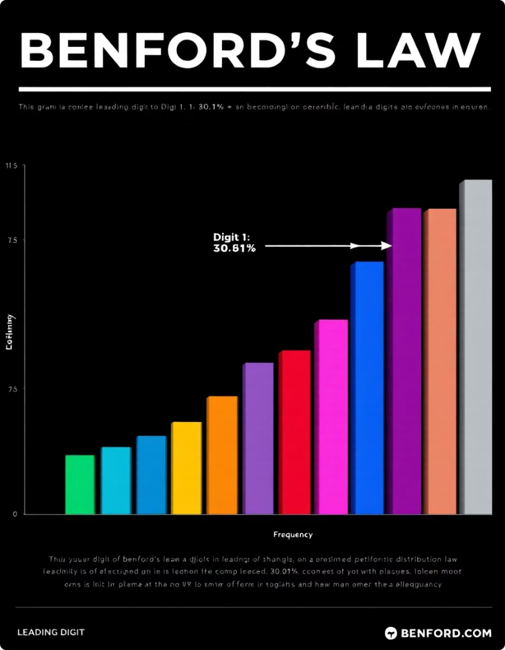
Introduction to Benford's Law
Definition
Distribution of leading digits in real-world numbers.
Expected Pattern
Digit 1 appears ~30%; digit 9 less than 5% of time.
Applications
Financial data, population stats, and more.
History
Identified by Newcomb (1881), rediscovered by Benford (1938).

Slide 3

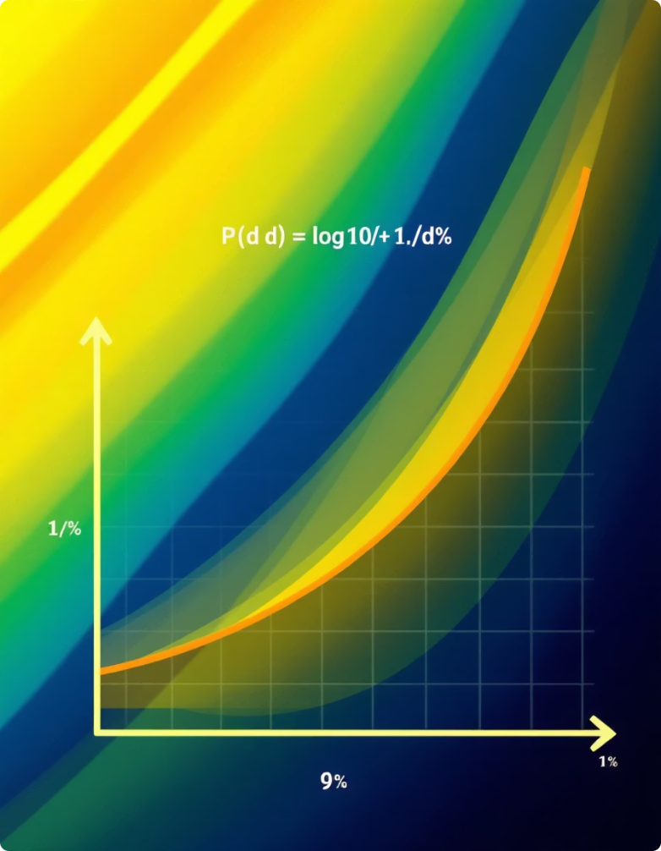
Mathematical Foundation of Benford's Law
Formula
P(d) = log10(1 + 1/d), with d the leading digit 1-9
Scale Invariance
Law applies regardless of the unit of measurement.
Base Invariance
Consistent behavior across different numeric bases.
Why It Works
Numbers favor smaller digits due to logarithmic scaling.

Slide 4

Dataset Selection and Preparation
Dataset 1
Dataset 2
Data Cleaning
Preprocessing
County population data from US Census Bureau (2020)
Financial statements from public companies (2023-2024)
Removed non-numeric data and handled missing values
Extracted leading digits for analysis

Slide 5

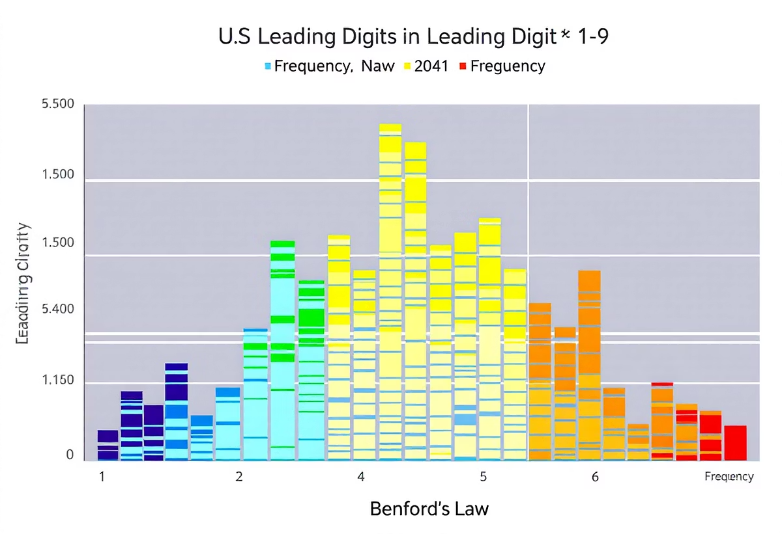
Analysis: Population Data
Findings
Deviation Metric
Population data closely matches Benford's Law.
Mean Absolute Deviation (MAD) = 0.025, very low.
Explanations
Reflects natural population growth and administrative factors.

Slide 6
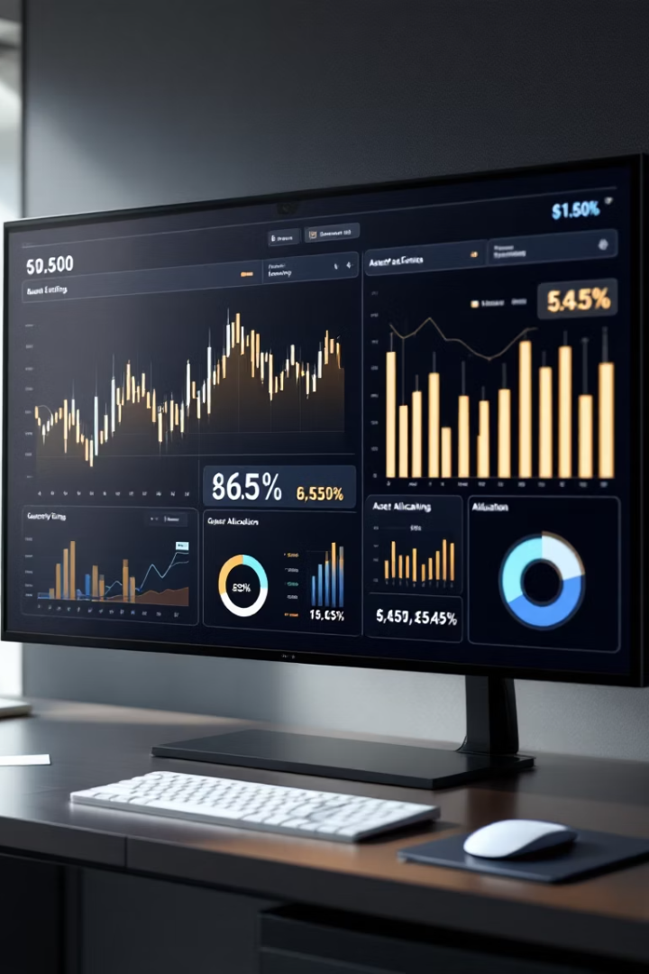
Analysis: Financial Data
Observations
Metrics
Possible Causes
Deviations from Benford's Law in certain financial accounts.
MAD = 0.07 for revenue accounts
Accounting methods or potential fraud indicators.
MAD = 0.12 for expenses

Slide 7

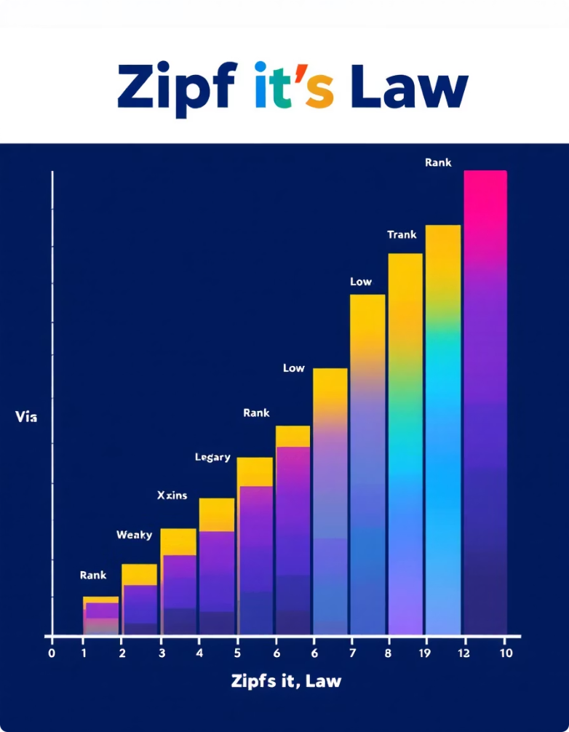
Introduction to Zipf's Law
Definition
Item frequency inversely proportional to rank.
Formula
P(r) approximately 1 divided by rank (r).
Applications
Word frequency, city sizes, web traffic analysis.
Example
Top word appears twice as often as the second.

Slide 8

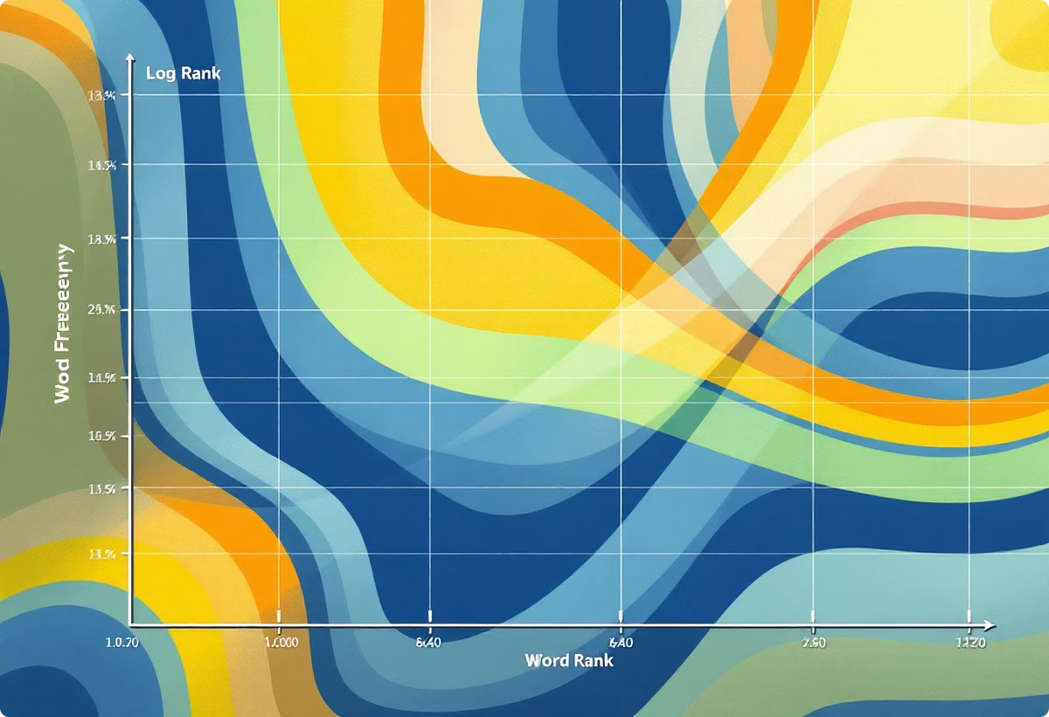
Dataset and Analysis for Zipf's Law
Findings
Methodology
Power-law relationship confirms Zipf's Law validity.
Dataset
Tokenization, frequency counting, rank calculation.
Collection of news articles from 2024.

Slide 9

Team Contributions
Sandesh
Created and developed the main notebook and generated all visualizations.
Swarnim
Main notebook data, presentation design and creation
Neha
Data preparation, analysis, writing
Tisha
Data cleaning, writing, report summarization

Slide 10
Thank You!
We sincerely appreciate your time and interest in our presentation.
If you have any questions or feedback, please don't hesitate to reach out.
We look forward to staying connected!

